Slide 1
Maze Solver
Team 11 Flood Fill
Prashant Gupta | 2020102030 - ECE
Tarun | 2020102056 - ECE
Prasoon Garg | 2020102049 - ECE
Snehit Gupta | 2020112025 - ECD
Mentor TA - Eshan Gupta
Repo Link - https://github.com/Digital-Image-Processing-IIITH/dip-m22-project-flood-fill

Slide 2
TABLE OF CONTENTS
01
02
03
04
INTRODUCTION
METHODOLOGY
RESULTS
CONCLUSIONS

Slide 3
INTRODUCTION
Solving mazes and extracting shortest path solutions
have a number of applications within image processing.
we provide an algorithm which is used to detect and solve rectangular mazes using various Digital Image Processing and Game Theory Concepts.

Slide 4
ROADMAP FOR MAZE SOLVER
MAZE EXTRACTION
PATH FINDER
GATE FINDING
SOLUTION OVERLAY
PRE
PROCESSING

Slide 5
Methodology
We can broadly classify our method into 5 steps. They are
Pre - Processing
Maze Extraction
Gate Detection
Path Finding
Solution Overlay

Slide 6
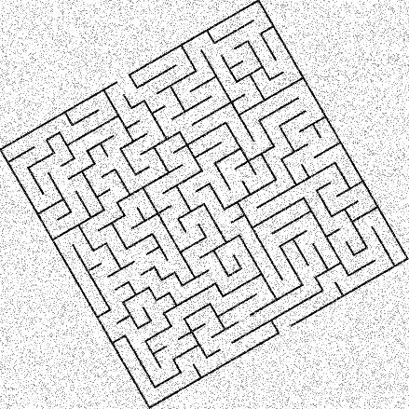
ORIGINAL IMAGE
This is rotated input image which contains salt noise as well.
Now we explain how we are going to extract the Maze solution for the given Maze in the upcoming Slides.

Slide 7
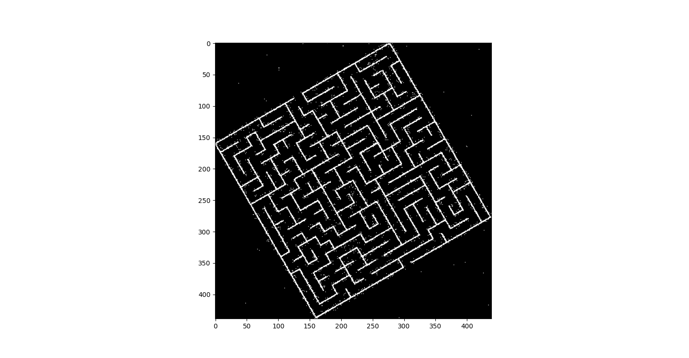
PRE PROCESSING
Convert the Image to Grayscale.
Use openCv function - fastNlMeansDenoising to remove the Noise.
Binarization of Image is done by using Otsu’s Thresholding.
Inverting the Binary Image.

Slide 8
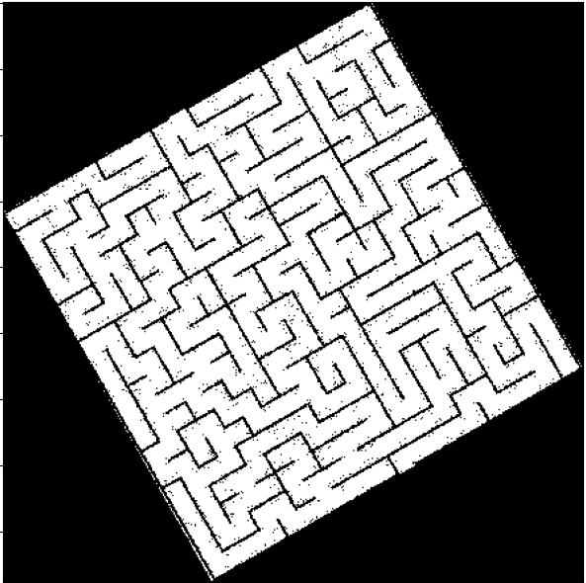
MAZE EXTRACTION
The inverted binary image is labelled using connected components.
Pixels with the top two most occurring labels are picked.
Using this pixels we find the corners by sorting separately in x and y direction and arranged in clockwise order.
Binary mask is made using openCV fillPoly function.
This Binary masked is multiplied with preprocessing image to obtain the maze.

Slide 9
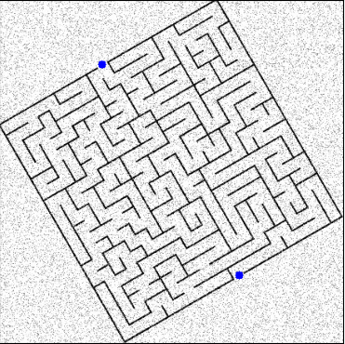
GATE FINDING
The corners obtained from the maze extraction are used create four lines which are the border of the maze.
Iterate in these lines to check for points whose neighbourhood in k*k (k = 3) has no component of maze wall.
The obtained points are shifted a little inside the Maze.
These points are considered as the gates for the maze.

Slide 10
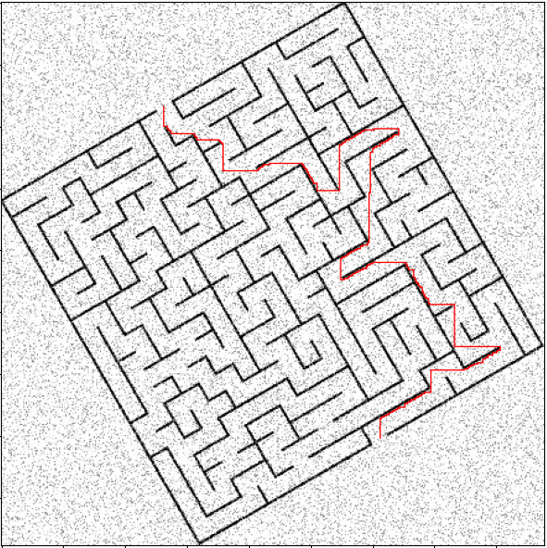
PATH FINDER
The path finder uses the extracted maze and the gates to obtain the shortest path.
A modified version of the BFS algorithm is used.
In this we store the distance of every pixel from the source point.
Once destination is reached the points are iterated back such that the distance is minimum.

Slide 11
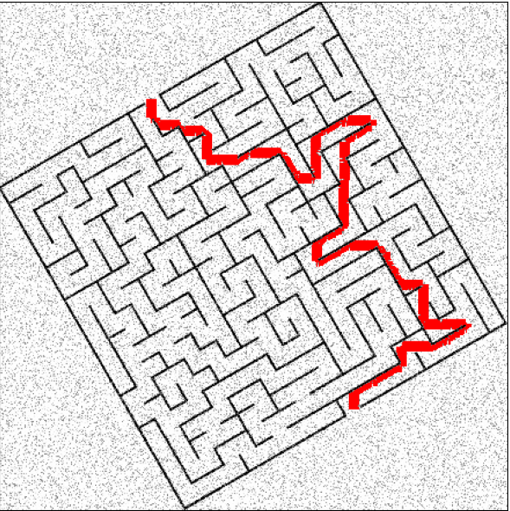
SOLUTION OVERLAY
The output from the path finder is extremely thin(1 pixel wide).
Using the path we got from Path finder we broaden the final output line.
The Broadening is done based on the previous point was in the horizontal direction or the vertical direction.
It is taken care that the broaden part does not overlap with the walls of maze.

Slide 12
Results
We have tested our code on various kinds of maze.
Some of them are :
Simple Maze 10*10
Large Mazes 50*50
Rotated Mazes
Noisy Mazes
Hand-drawn mazes
Pitch Rotated

Slide 13
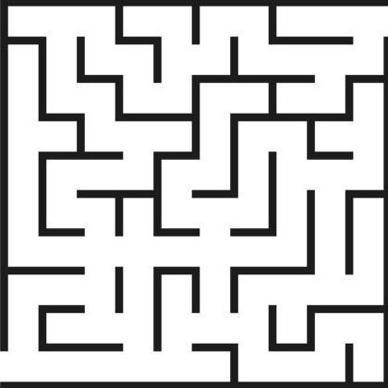
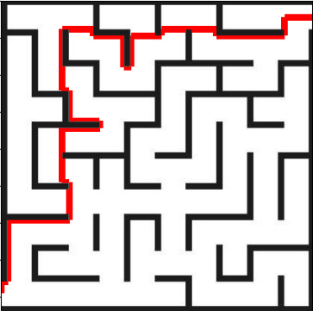
RESULTS

Slide 14
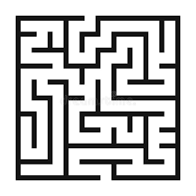
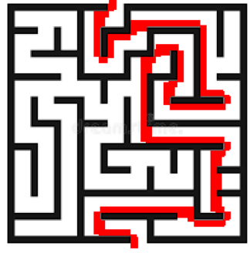
RESULTS

Slide 15
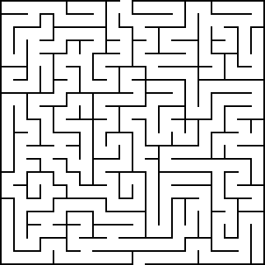
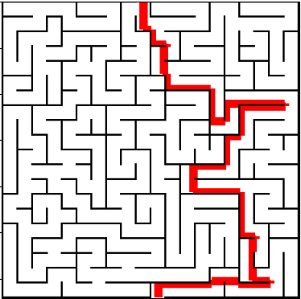
RESULTS

Slide 16
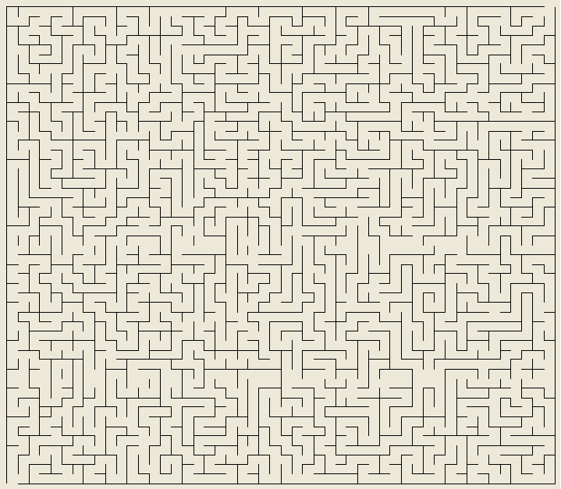
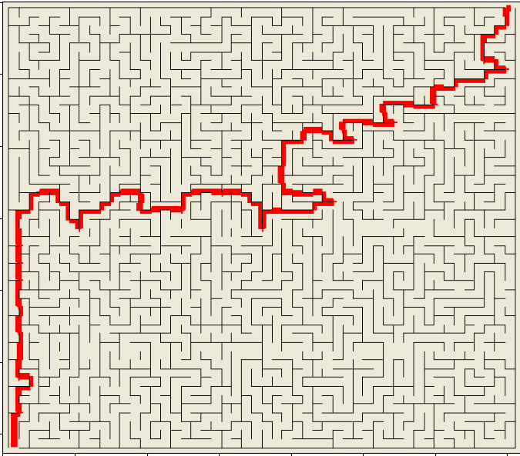
RESULTS

Slide 17
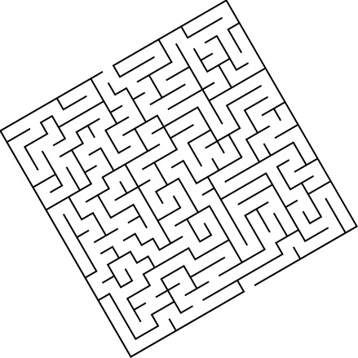
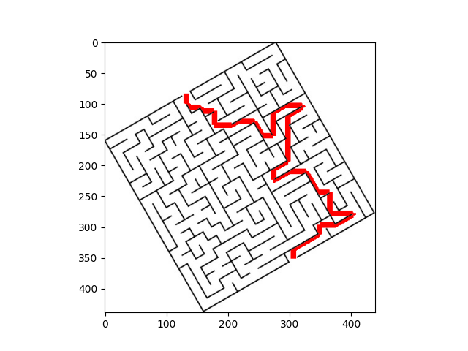
RESULTS

Slide 18
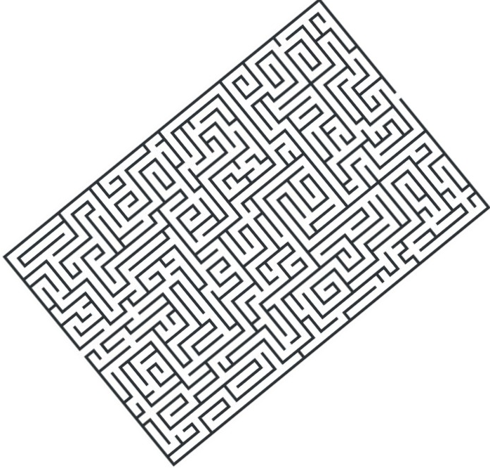
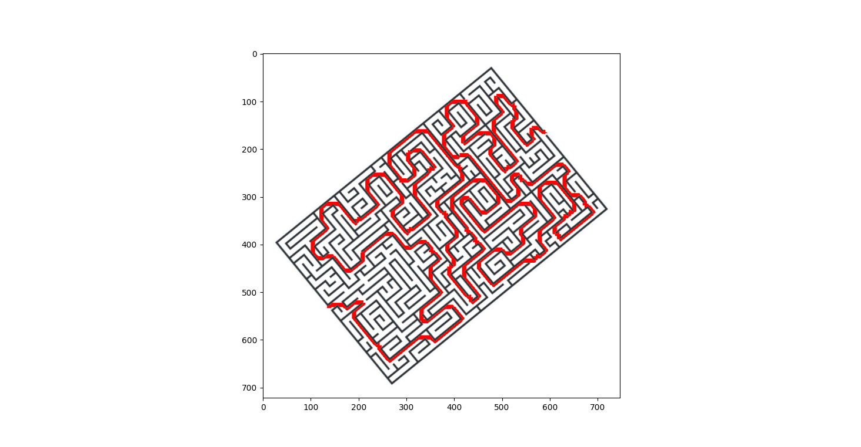
RESULTS

Slide 19
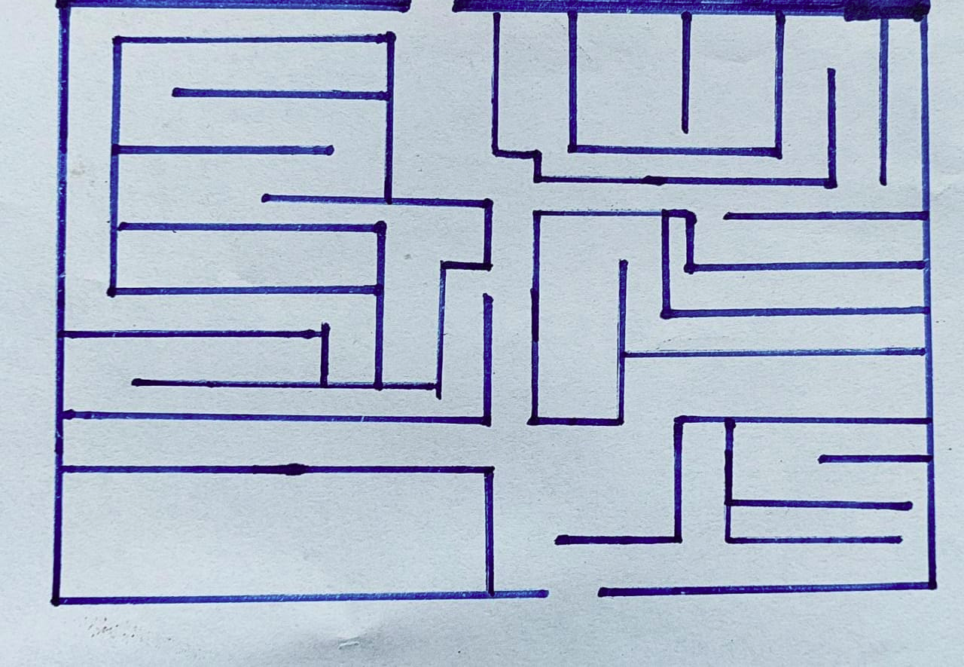
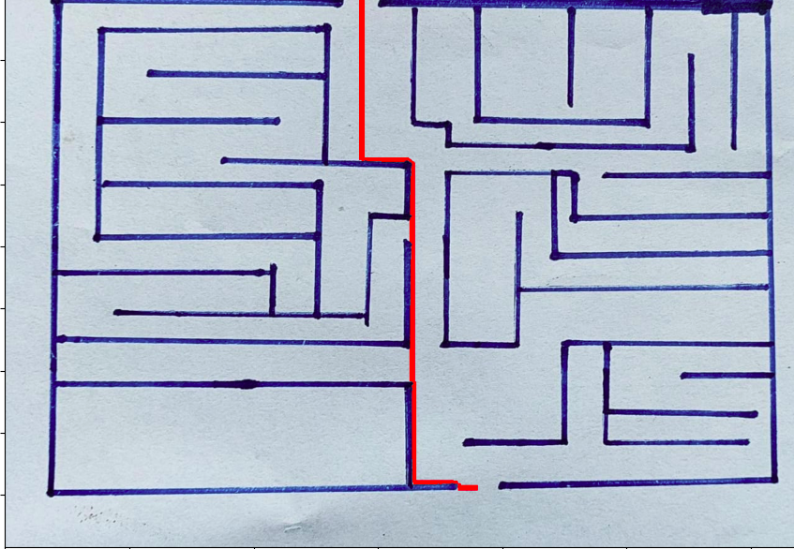
RESULTS

Slide 20
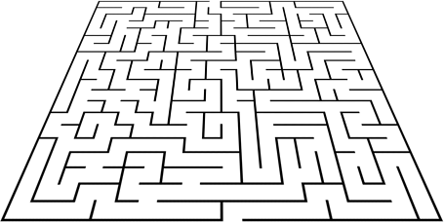
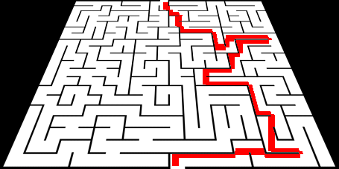
RESULTS

Slide 21
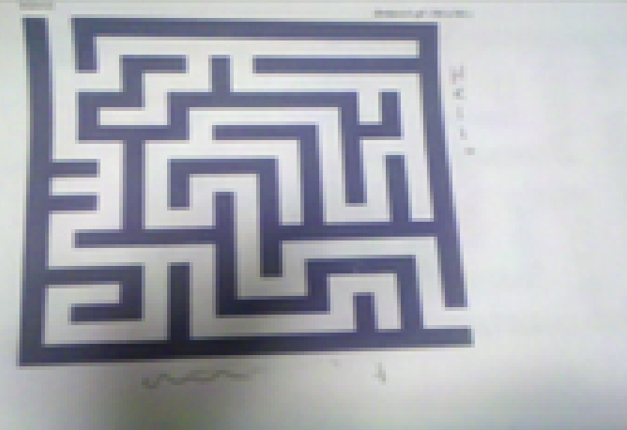
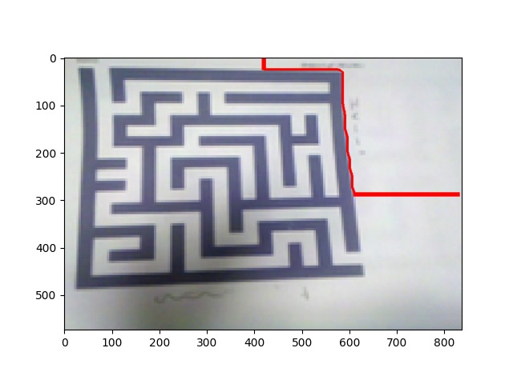
Failed Test Cases
In this test case due to the shadow the otsu thresholding was not proper and hence gate detection provided incorrect gates.

Slide 22
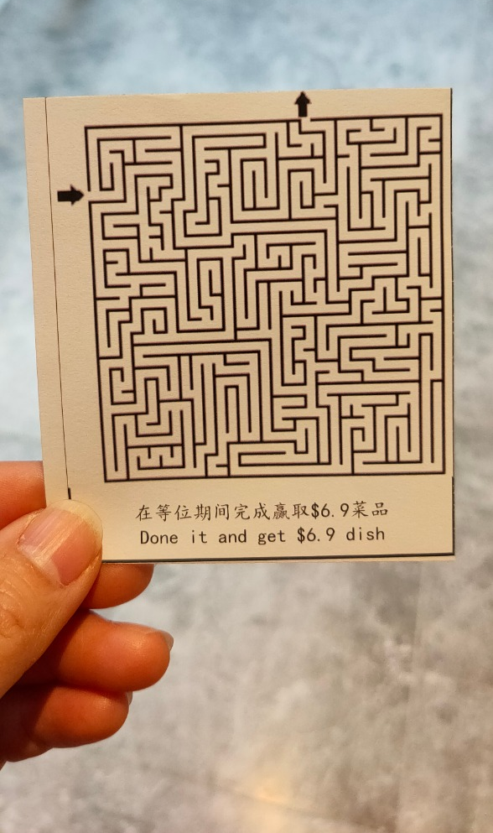
Failed Test Cases
This test case has failed since there is too much variation in the background instead of simple noise.
Hence the maize extraction function failed to extract the maze and displayed the error.

Slide 23
Application
Applications of maze solving systems include intelligent traffic control that helps ambulances, fire fighters, or rescuing robots to find their shortest path to their destination.
The images are mostly the ones which are obtained from satellites and using image segmentation we can remove the unnecessary area and apply maze solving technique to obtain the shortest path.

Slide 24
CONTRIBUTION
Prashant Gupta | Maze Extraction,Path Finder
Tarun | Gate Finding,Testing and Debugging,slides
Prasoon Garg | Path Finder, Solution Overlay
Snehit Gupta | Gate Finder,Pre-processing

Slide 25
THANK YOU

